Slide 1

Effective Java Lambdas and Streams
Using Joshua Bloch’s Effective Java Book Third Edition
and Modern Java in Action Book
Azat Satklichov
azats@seznam.cz,
http://sahet.net/htm/java.html,
https://github.com/azatsatklichov/java-in-deep
Notes:
JSLint can be found at http://www.JSLint.com/.
JavaScript statements are composed of: Values, Operators, Expressions, Keywords, and Comments.
JavaScript programs (and JavaScript statements) are often called JavaScript code.
var x, y, z; // Statement 1 x = 5; // Statement 2 y = 6; // Statement 3
var x = 5 * 10; //Statement 4
JavaScript uses the var keyword to declare variables.
An expression is a combination of values, variables, and operators, which computes to a value. E.g. 5 * 10 or x * 10
JavaScript variables are containers for storing data values.
All JavaScript variables must be identified with unique names. JavaScript identifiers are case-sensitive.
Creating a variable in JavaScript is called declaring a variable.
var carName;
Difference Between Unicode and UTF-8: Unicode is a character set. UTF-8 is encoding.
Unicode is a list of characters with unique decimal numbers (code points). A = 65, B = 66, C = 67, ....
This list of decimal numbers represent the string ahello: 97 104 101 108 108 111
Encoding is how these numbers are translated into binary numbers to be stored in a computer:
UTF-8 encoding will store hello like this (binary): 01101000 01100101 01101100 01101100 01101111
Encoding translates numbers into binary . Character sets translates characters to numbers.

Slide 2
Effective Java Lambdas and Streams
Using Joshua Bloch’s Effective Java Book Third Edition
and Modern Java in Action Book
Azat Satklichov
azat.satklichov@broadcom.com

Slide 3
Agenda
Java 8 Fundamentals (Behavior parameterization, Lambda Expression,..)
Functional Interfaces
Filters
Item 42: Prefer lambdas to anonymous classes
Item 43: Prefer method references to lambdas
Item 44: Favor the use of standard functional interfaces
Item 45: Use streams judiciously
Item 46: Prefer side-effect-free functions in streams
Item 47: Prefer Collection to Stream as a return type
Item 48: Use caution when making streams parallel
https://mkyong.com/tutorials/java-8-tutorials/
Notes:
https://developer.mozilla.org/en-US/docs/Web/HTTP/Caching
https://www.restapitutorial.com/httpstatuscodes.html
https://www.tutorialspoint.com/http/http_caching.htm
https://www.baeldung.com/java-exceptions
http://tutorials.jenkov.com/java-exception-handling/checked-or-unchecked-exceptions.html
We usually write code in an idealized environment: the filesystem always contains our files, the network is healthy, and the JVM always has enough memory. Sometimes we call this the happy path.

Slide 4
Why are anonymous inner classes unsatisfactory?
invokedynamic bytecode in JDK7)
three such programming concepts that have driven the development of the Java 8 features
The first programming concept is stream processing.
The second programming concept added to Java 8 is the ability to pass a piece of code to an API.
Passing code to methods with behavior parameterization
The third programming concept is rather more implicit and arises from the phrase
“parallelism almost for free” in our previous discussion on stream processing.
Notes:
For introductory purposes, a stream
is a sequence of data items that are conceptually produced one at a time.

Slide 5
Stream Processing
The first programming concept is stream processing. E.g. car-assembly – stream of chars, ..
cat file1 file2 | tr "[A-Z]" "[a-z]" | sort | tail -3
Java 8 adds a Streams API (note the uppercase S) in java.util.stream based on this idea; Stream<T> is a sequence of items of type T. You can think of it as a fancy iterator for now.
The key motivation for this is that you can now program in Java 8 at a higher level
of abstraction, structuring your thoughts of turning a stream of this into a stream of
that (similar to how you think when writing database queries) rather than one item at
a time. Another advantage is that Java 8 can transparently run your pipeline of Stream
operations on several CPU cores on disjoint parts of the input—this is parallelism
almost for free instead of hard work using Threads.
Notes:
For introductory purposes, a stream
is a sequence of data items that are conceptually produced one at a time.

Slide 6
Streams (lazy, immediate, … ),…
…. From Modern JAVA in Action
java.util.function
Notes:
In Java 8, the language formalized the notion that interfaces with a single
abstract method are special and deserve special treatment. These interfaces are
now known as functional interfaces, and the language allows you to create
instances of these interfaces using lambda expressions, or lambdas for short.

Slide 7
Nearly every Java application makes and processes collections.
Using a collection, you’re managing the iteration process yourself. You need to iterate through the elements one by one using a foreach loop processing them in turn. We call this way of iterating over data external iteration.
In contrast, using the Streams API, you don’t need to think in terms of loops. The data processing happens internally inside the library. We call this idea internal iteration.
But it’s useful for now to keep in mind that Collections is mostly about storing and accessing data,
whereas Streams is mostly about describing computations on data.
The key point here is that the Streams API allows and encourages the elements within a stream to be
processed in parallel.

Slide 8
Streams differ from collections in several ways:
- No storage. A stream is not a data structure that stores elements; instead, it conveys elements from a source such as a data structure, an array, a generator function, or an I/O channel, through a pipeline of computational operations.
Functional in nature. An operation on a stream produces a result, but does not modify its source.
- Laziness-seeking. Many stream operations, such as filtering, mapping, or duplicate removal, can be implemented lazily, exposing opportunities for optimization. Stream operations are divided into intermediate (Stream-producing) operations and terminal (value- or side-effect-producing) operations. Intermediate operations are always lazy.
- Possibly unbounded. While collections have a finite size, streams need not. Short-circuiting operations such as limit(n) or findFirst() can allow computations on infinite streams to complete in finite time.
Consumable. The elements of a stream are only visited once during the life of a stream. Like an Iterator, a new stream must be generated to revisit the same elements of the source.
Streams can be obtained in a number of ways. Some examples include:
- From a Collection via stream() and parallelStream() methods;
- From an array via Arrays.stream(Object[]);
- static factory methods: Stream.of(Object[]), IntStream.range(int, int) or Stream.iterate(Object, UnaryOperator);
- The lines of a file can be obtained from BufferedReader.lines();
- Streams of file paths can be obtained from methods in Files;
- Streams of random numbers can be obtained from Random.ints();
- Numerous other stream-bearing methods in the JDK, including BitSet.stream(), Pattern.splitAsStream(java.lang.CharSequence), and JarFile.stream().
Notes:
The key abstraction introduced in this package is stream. The classes Stream, IntStream, LongStream, and DoubleStream are streams over objects and the primitive int, long and double types. Streams differ from collections in several ways:
No storage. A stream is not a data structure that stores elements; instead, it conveys elements from a source such as a data structure, an array, a generator function, or an I/O channel, through a pipeline of computational operations.
Functional in nature. An operation on a stream produces a result, but does not modify its source. For example, filtering a Stream obtained from a collection produces a new Stream without the filtered elements, rather than removing elements from the source collection.
Laziness-seeking. Many stream operations, such as filtering, mapping, or duplicate removal, can be implemented lazily, exposing opportunities for optimization. For example, "find the first String with three consecutive vowels" need not examine all the input strings. Stream operations are divided into intermediate (Stream-producing) operations and terminal (value- or side-effect-producing) operations. Intermediate operations are always lazy.
Possibly unbounded. While collections have a finite size, streams need not. Short-circuiting operations such as limit(n) or findFirst() can allow computations on infinite streams to complete in finite time.
Consumable. The elements of a stream are only visited once during the life of a stream. Like an Iterator, a new stream must be generated to revisit the same elements of the source.
Streams can be obtained in a number of ways. Some examples include:From a Collection via the stream() and parallelStream() methods;
From an array via Arrays.stream(Object[]);
From static factory methods on the stream classes, such as Stream.of(Object[]), IntStream.range(int, int) or Stream.iterate(Object, UnaryOperator);
The lines of a file can be obtained from BufferedReader.lines();
Streams of file paths can be obtained from methods in Files;
Streams of random numbers can be obtained from Random.ints();
Numerous other stream-bearing methods in the JDK, including BitSet.stream(), Pattern.splitAsStream(java.lang.CharSequence), and JarFile.stream().

Slide 9
Behavior parameterization is the ability for a method to take multiple different
behaviors as parameters and use them internally to accomplish different behaviors.
Behavior Parameterization
Passing code to methods with behavior parameterization
The second programming concept added to Java 8 is the ability to pass a piece of code to an API.
Java 8 adds the ability to pass methods (your code) as arguments to other methods.
We also refer to this conceptually as behavior parameterization (in OO behavior or action is used for methods, state is for fields).
The Streams API is built on the idea of passing code to parameterize the behavior of its operations, just as you passed compareUsingCustomerId to parameterize the behavior of sort.
File[] hiddenFiles = new File(".").listFiles(new FileFilter() {
public boolean accept(File file) {
return file.isHidden();
}
});
File[] hiddenFiles = new File(".").listFiles(File::isHidden)
Use a functional interface to pass behaviors
Notes:
Behavior parameterization lets you make your code more adaptive to changing requirements and saves on engineering efforts in the future.
Passing code is a way to give new behaviors as arguments to a method. But it’s verbose prior to Java 8. Anonymous classes helped a bit before Java 8 to get rid
of the verbosity associated with declaring multiple concrete classes for an interface that are needed only once.

Slide 10
Behavior parameterization is a software development pattern that lets you handle frequent requirement changes. In a nutshell, it means taking a block of code and making it available without executing it.
For example, you may have used the behavior parameterization pattern already, using existing classes and interfaces in the Java API to sort a List, to filter names of files, or to tell a Thread to execute a block of code or even perform GUI event handling. You’ll soon realize that this pattern is historically verbose in Java. Lambda expressions in Java 8 onward tackle the problem of verbosity.
Anonymous classes
Anonymous classes are like the local classes (a class defined in a block) that you’re already familiar with in Java. But anonymous classes don’t have a name.
Thread t = new Thread(() -> System.out.println("Hello world"));
Thread t = new Thread(new Runnable() {
public void run() {
System.out.println("Hello world");
}
});
Future<String> threadName = executorService.submit(
() -> Thread.currentThread().getName());
ExecutorService executorService = Executors.newCachedThreadPool();
Future<String> threadName = executorService.submit(new Callable<String>() {
@Override
public String call() throws Exception {
return Thread.currentThread().getName();
}
});

Slide 11
Parallelism and shared mutable data
The third programming concept is rather more implicit and arises from the phrase “parallelism almost for free” in our previous discussion on stream processing.
Using synchronized across multiple processing cores is often far more expensive than you expect, because synchronization forces code to execute sequentially, which works against the goal of parallelism.
Two of these points (no shared mutable data and the ability to pass methods and functions—code—to other methods) are the cornerstones of what’s generally described as the paradigm of functional programming,
Parallelism in Java and no shared mutable state
People have always said parallelism in Java is difficult, and all this stuff about synchronized is error-prone. Where’s the magic bullet in Java 8?
There are two magic bullets. First, the library handles partitioning—breaking down a big stream into several smaller streams to be processed in parallel for you. Second, this parallelism almost for free from streams, works only if the methods passed to library methods like filter don’t interact (for example, by having mutable shared
objects).
Notes:
Two of these points (no shared mutable data and the ability to pass methods and functions—code—to other methods) are the cornerstones of what’s generally described as the paradigm of functional programming,
In contrast, in the imperative programming paradigm you typically describe a program
in terms of a sequence of statements that mutate state.
The no-shared-mutabledata requirement means that a method is perfectly described solely by the way it transforms
arguments to results; in other words, it behaves as a mathematical function and has no (visible) side effects.

Slide 12
LambdaExpressionsNotFullyLikeInnerClasses
Lambda Expressions – Not fully Like Inner Classes
A lambda expression can be understood as a concise representation of an anonymous function that can be passed around. It doesn’t have a name, but it has a list of parameters, a body, a return type, and also possibly a list of exceptions that can be thrown. That’s one big definition; let’s break it down:
○ Anonymous—We say anonymous because it doesn’t have an explicit name like a method would normally have; less to write and think about!
○ Function—We say function because a lambda isn’t associated with a particular class like a method is. But like a method, a lambda has a list of parameters, a body, a return type, and a possible list of exceptions that can be thrown.
○ Passed around—A lambda expression can be passed as argument to a method or stored in a variable.
○ Concise—You don’t need to write a lot of boilerplate like you do for anonymous classes.
Why should you care about lambda expressions? You saw in the previous chapter that passing code is currently tedious and verbose in Java. Well, good news! Lambdas fix this problem; they let you pass code in a concise way. Lambdas technically don’t let you do anything that you couldn’t do prior to Java 8.
Lambda expressions will encourage you to adopt the style of behavior parameterization that we described in the previous chapter.
Where exactly can you use lambdas? You can use a lambda expression in the context of a functional interface.
Meaning of THIS in Lambdas? Also, ???? Synthetic-method, … method-invoke ;;;behind the technology…

Slide 13
Lambdas are limited to functional interfaces.
If you want to create an instance of an abstract class, you can do it with an anonymous class, but not a lambda.
Similarly, you can use anonymous classes to create instances of interfaces with multiple abstract methods.
- Finally, a lambda cannot obtain a reference to itself. In a lambda, the this keyword refers to the enclosing instance, which is typically what you want. In an anonymous class, the this keyword refers to the anonymous class instance. If you need access to the function object from within its body, then you must use an anonymous class.
In summary, as of Java 8, lambdas are by far the best way to represent small
function objects. Don’t use anonymous classes for function objects unless you
have to create instances of types that aren’t functional interfaces. Also,
remember that lambdas make it so easy to represent small function objects that it
opens the door to functional programming techniques that were not previously
practical in Java.
Notes:
Likewise, you might think that anonymous classes are obsolete in the era of
lambdas. This is closer to the truth, but there are a few things you can do with
anonymous classes that you can’t do with lambdas. Lambdas are limited to functional
interfaces. If you want to create an instance of an abstract class, you can do
it with an anonymous class, but not a lambda. Similarly, you can use anonymous
classes to create instances of interfaces with multiple abstract methods. Finally, a
lambda cannot obtain a reference to itself. In a lambda, the this keyword refers to
the enclosing instance, which is typically what you want. In an anonymous class,
the this keyword refers to the anonymous class instance. If you need access to the
function object from within its body, then you must use an anonymous class.
In summary, as of Java 8, lambdas are by far the best way to represent small
function objects. Don’t use anonymous classes for function objects unless you
have to create instances of types that aren’t functional interfaces. Also,
remember that lambdas make it so easy to represent small function objects that it
opens the door to functional programming techniques that were not previously
practical in Java.

Slide 14
Lambdas
Avoid Global Variables: Global variables and functions can be overwritten by other scripts
Beware of Automatic Type Conversions: 3+2=32, 3-1=2 Confusing Addition & Concatenation
Use Parameter Defaults: otherwise undefined if not provided
Avoid using eval() : run text as code, security issue, like bat or shell files
Misunderstanding Floats: var y = 0.2; var z = x + y // result in z will not be 0.3;
,..
Streams
Avoid Global Variables: Global variables and functions can be overwritten by other scripts
Beware of Automatic Type Conversions: 3+2=32, 3-1=2 Confusing Addition & Concatenation
Use Parameter Defaults: otherwise undefined if not provided
Avoid using eval() : run text as code, security issue, like bat or shell files
Misunderstanding Floats: var y = 0.2; var z = x + y // result in z will not be 0.3;
,..

Slide 15
For example, consider the removeIf method, which was added to the Collection interface in Java 8.
This is the best general-purpose implementation one could possibly write for the removeIf method, but sadly, it fails on some real-world Collection implementations. For example, consider org.apache.commons.collections4.-
collection.SynchronizedCollection. This class, from the Apache Commons library, is similar to the one returned by the static factory Collections.- synchronizedCollection in java.util.
If this class is used in conjunction with Java 8, it will therefore inherit the default implementation
of removeIf, which does not, indeed cannot, maintain the class’s fundamental promise: to automatically synchronize around each method invocation.
If a client calls the removeIf method on a SynchronizedCollection instance in the presence of concurrent modification
of the collection by another thread, a ConcurrentModificationException or other unspecified behavior may result.
Putting lambdas into practice:
the execute-around pattern
Let’s look at an example of how lambdas, together with behavior parameterization,
can be used in practice to make your code more flexible and concise.

Slide 16
Functional Interfaces ,…
…. From Modern JAVA in Action
java.util.function
@FunctionalInterface annotation (not-mandatory like @Override, but helpful to show compile-error in case err.) is used to indicate that the interface is intended to be a functional interface and is therefore useful for documentation.
Putting lambdas into practice: the execute-around pattern
Let’s look at an example of how lambdas, together with behavior parameterization, can be used in practice to make your code more flexible and concise.
A recurrent pattern in resource processing (for example, dealing with files or databases) is to open a resource, do some processing on it, and then close the resource. The setup and cleanup phases are always similar and surround the important code doing the processing. This is called the execute-around pattern,
Use a functional interface to pass behaviors:
lambdas can be used only in the context of a functional interface.
Notes:
In Java 8, the language formalized the notion that interfaces with a single
abstract method are special and deserve special treatment. These interfaces are
now known as functional interfaces, and the language allows you to create
instances of these interfaces using lambda expressions, or lambdas for short.

Slide 17
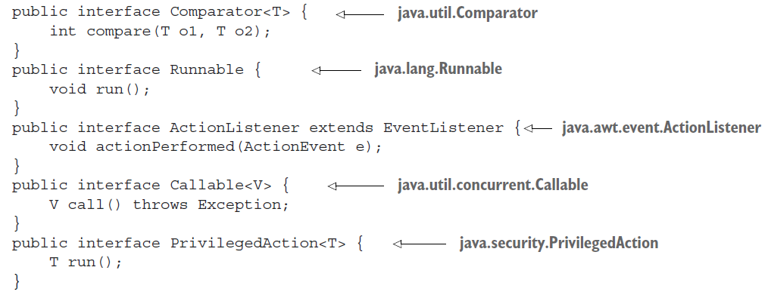
Functional interface
is an interface that specifies exactly one abstract method.
An interface is still a functional interface if it has many default methods as long as it specifies only one
abstract method.
What can you do with functional interfaces? Lambda expressions let you provide the implementation of the abstract method of a functional interface directly inline and treat the whole expression as an instance of a functional interface (more technically speaking, an instance of a concrete implementation of the functional interface). You can achieve the same thing with an anonymous inner class, although it’s clumsier: you provide an
implementation and instantiate it directly inline.

Slide 18
Function descriptor
The signature of the abstract method of the functional interface describes the signature of the lambda expression.
We call this abstract method a function descriptor.
For example, the Runnable interface can be viewed as the signature of a function that accepts nothing and returns nothing (void) because it has only one abstract method called run, which accepts nothing and returns nothing (void). As another example, (Apple, Apple) -> int denotes a function taking two Apples as parameters and returning an int.
how the compiler checks whether a lambda is valid in a given context
You may be wondering, “Why can we pass a lambda only where a functional interface is expected?”
Notes:
In addition, most Java programmers are already familiar with the idea of an interface with a single abstract method (for example, for event handling). However,
the most important reason is that functional interfaces were already extensively used before Java 8.

Slide 19
What is Functional Interface? Predicate ? Supplier? …
The word predicate is often used in mathematics to mean something
function-like that takes a value for an argument and returns true or false.
Using functional interfaces
Several functional interfaces are already available in the Java API such as Comparable, Runnable, and Callable. The Java library designers for Java 8 have helped you by introducing several new functional interfaces inside the java.util.function package.
We’ll describe the interfaces Operator, Predicate, Consumer, and Function.
Comparator, Runnable, ActionListener, Callable, PrivilegedAction
Notes:
More generally, you’ll be writing more constructors and methods that take function objects as parameters.
Choosing the right functional parameter type demands care.
The java.util.function package provides a large collection of standard functional interfaces for your use
Comparator, Runnable, ActionListener, Callable, PrivilegedAction
What can you do with functional interfaces? Lambda expressions let you provide the
implementation of the abstract method of a functional interface directly inline and
treat the whole expression as an instance of a functional interface (more technically speaking,
an instance of a concrete implementation of the functional interface).

Slide 20
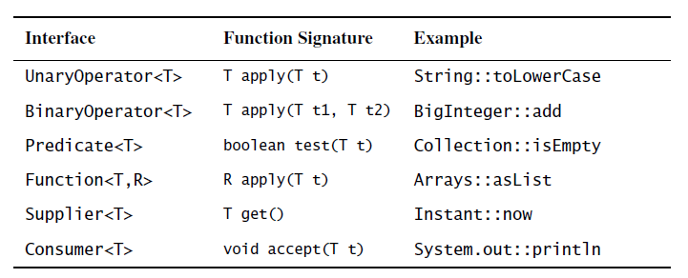
What is Functional Interface? Predicate ? Supplier? …
The java.util.function package provides a large collection of standard functional interfaces for your use
There are forty-three interfaces in java.util.Function. You can’t be expected to remember them all, but if you remember six basic interfaces, you can derive the rest when you need them.
MethodReference
The Operator interfaces represent functions whose result and argument types are the same. The Predicate interface represents a function that takes an argument and returns a boolean. The Function interface represents a function whose argument and return types differ. The Supplier interface represents a function that takes no arguments and returns (or “supplies”) a value. Finally, Consumer represents a function that takes an argument and returns nothing, essentially consuming its argument. The six basic functional interfaces are summarized below:
There are also three variants of each of the six basic interfaces to operate on the primitive types int, long, and double.
Always annotate your functional interfaces with the @FunctionalInterface annotation
Notes:
More generally, you’ll be writing more constructors and methods that take function objects as parameters.
Choosing the right functional parameter type demands care.
The java.util.function package provides a large collection of standard functional interfaces for your use

Slide 21
Predicate
The java.util.function.Predicate<T> interface defines an abstract method named
test that accepts an object of generic type T and returns a boolean.
@FunctionalInterface
public interface Predicate<T> {
boolean test(T t);
}
public <T> List<T> filter(List<T> list, Predicate<T> p) {
List<T> results = new ArrayList<>();
for(T t: list) {
if(p.test(t)) {
results.add(t);
}
}
return results;
}
Predicate<String> nonEmptyStringPredicate = (String s) -> !s.isEmpty();
List<String> nonEmpty = filter(listOfStrings, nonEmptyStringPredicate);
Notes:
In a nutshell, a functional interface is an interface that specifies exactly one abstract
method. You already know several other functional interfaces in the Java API such as
Comparator and Runnable

Slide 22
Predicate
The java.util.function.Predicate<T> interface defines an abstract method named
test that accepts an object of generic type T and returns a boolean. E.g. PredicateOr, ..
@FunctionalInterface
public interface Predicate<T> {
boolean test(T t);
}
public <T> List<T> filter(List<T> list, Predicate<T> p) {
List<T> results = new ArrayList<>();
for(T t: list) {
if(p.test(t)) {
results.add(t);
}
}
return results;
}
Predicate<String> nonEmptyStringPredicate = (String s) -> !s.isEmpty();
List<String> nonEmpty = filter(listOfStrings, nonEmptyStringPredicate);

Slide 23
Function
The java.util.function.Function<T, R> interface defines an abstract method named apply that takes an object of generic type T as input and returns an object of generic type R. You might use this interface when you need to define a lambda that maps information from an input object to an output
@FunctionalInterface
public interface Function<T, R> {
R apply(T t);
}
public <T, R> List<R> map(List<T> list, Function<T, R> f) {
List<R> result = new ArrayList<>();
for(T t: list) {
result.add(f.apply(t));
}
return result;
}
// [7, 2, 6]
List<Integer> l = map(
Arrays.asList("lambdas", "in", "action"), (String s) -> s.length() );

Slide 24
Predicate
The java.util.function.Predicate<T> interface defines an abstract method named
test that accepts an object of generic type T and returns a boolean. E.g. PredicateOr, ..
@FunctionalInterface
public interface Predicate<T> {
boolean test(T t);
}
public <T> List<T> filter(List<T> list, Predicate<T> p) {
List<T> results = new ArrayList<>();
for(T t: list) {
if(p.test(t)) {
results.add(t);
}
}
return results;
}
Predicate<String> nonEmptyStringPredicate = (String s) -> !s.isEmpty();
List<String> nonEmpty = filter(listOfStrings, nonEmptyStringPredicate);

Slide 26
Interface Default Method Ambiguities
DefaultAndStaticMethods

Slide 27
Default Methods in Interfaces
Avoid Global Variables: Global variables and functions can be overwritten by other scripts
Beware of Automatic Type Conversions: 3+2=32, 3-1=2 Confusing Addition & Concatenation
Use Parameter Defaults: otherwise undefined if not provided
Avoid using eval() : run text as code, security issue, like bat or shell files
Misunderstanding Floats: var y = 0.2; var z = x + y // result in z will not be 0.3;
,..

Slide 28
Item 42: Prefer lambdas to anonymous classes
// Anonymous class instance as a function object - obsolete!
Collections.sort(words, new Comparator<String>() {
public int compare(String s1, String s2) {
return Integer.compare(s1.length(), s2.length());
}
});
e.g. SortFourWays
// Lambda expression as function object (replaces anonymous class)
Collections.sort(words, (s1, s2) -> Integer.compare(s1.length(), s2.length()));
@FI: DoubleBinaryOperator
e.g. Operation
The addition of lambdas to the language makes it practical to use function
objects where it would not previously have made sense.
// Enum type with constant-specific class bodies & data
public enum Operation {
//Enum with function object fields &
//constant-specific behavior
public enum Operation {
PLUS(+) { // Needs different behavior … -, *, /
public double apply(double x, double y) { return x + y; }
},
PLUS (+, (x, y) -> x + y),
Notes:
Note that the types of the lambda (Comparator<String>), of its parameters (s1 and s2, both String), and of its return value (int) are not present in the code.
The compiler deduces these types from context, using a process known as type inference.
Omit the types of all lambda parameters unless their
presence makes your program clearer. If the compiler generates an error telling you it can’t infer the type of a lambda parameter, then specify it. Sometimes you
may have to cast the return value or the entire lambda expression, but this is rare. One caveat should be added concerning type inference. Item 26 tells you not
Incidentally, the comparator in the snippet can be made even more succinct if a comparator construction method is used in place of a lambda (Items 14. 43): Collections.sort(words, comparingInt(String::length));
In fact, the snippet can be made still shorter by taking advantage of the sort method that was added to the List interface in Java 8: words.sort(comparingInt(String::length));
Lambdas make it easy to implement constant-specific behavior using the former instead of the latter.
The resulting code is simpler and clearer than the original version:
lambdas lack names and documentation; if a computation isn’t self-explanatory, or exceeds a few lines, don’t put it in a
lambda. One line is ideal for a lambda, and three lines is a reasonable maximum. If you violate this rule, it can cause serious harm to the readability of your programs.

Slide 29
Item 43: Prefer method references to lambdas
map.merge(key, 1, (count, incr) -> count + incr);
Note that this code uses the merge method, which was added to the Map
interface in Java 8.
e.g. SortFourWays
The code reads nicely, but there’s still some boilerplate. The parameters count
and incr don’t add much value, and they take up a fair amount of space.
map.merge(key, 1, Integer::sum);
The more parameters a method has, the more boilerplate you can eliminate with a method reference.
You can extract the code from the lambda into a new method and replace the lambda with a reference to that method.
e.g. Operation
You should usually, but not always, take the IDE up on the offer. Occasionally, a lambda will be more succinct than a method reference.
service.execute(GoshThisClassNameIsHumongous::action);
The lambda equivalent looks like his:
service.execute(() -> action());
Notes:
The primary advantage of lambdas over anonymous classes is that they are more Succinct (strucne – kisa ve oz).
Java provides a way to generate function objects even more succinct than lambdas: method references.
You can extract the code from the lambda into a new method and replace the lambda with a reference to that method.
You can give the method a good name and document it to your heart’s content.
If you’re programming with an IDE, it will offer to replace a lambda with a
method reference wherever it can.

Slide 30
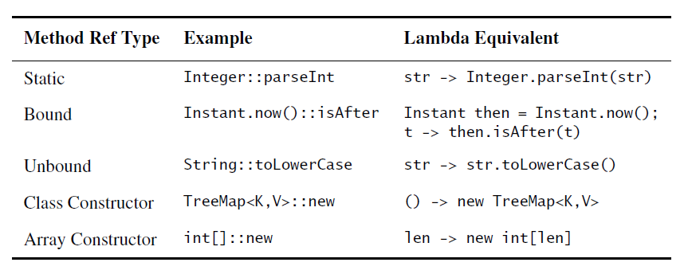
Many method references refer to static methods, but there are four kinds that do not.
Two of them are bound and unbound instance method references.
There are two kinds of constructor references, for classes and arrays.
Where method references are shorter and clearer, use them;
Where they aren’t, stick with lambdas.
Notes:
Many method references refer to static methods, but there are four kinds that
do not. Two of them are bound and unbound instance method references. In bound
references, the receiving object is specified in the method reference. Bound
references are similar in nature to static references: the function object takes the
same arguments as the referenced method. In unbound references, the receiving
object is specified when the function object is applied, via an additional parameter
before the method’s declared parameters. Unbound references are often used as
mapping and filter functions in stream pipelines (Item 45). Finally, there are two
kinds of constructor references, for classes and arrays. Constructor references
serve as factory objects. All five kinds of method references are summarized in the
table below:

Slide 31
Item 44: Favor the use of standard functional interfaces
The java.util.function package provides a large collection of standard functional interfaces for your use
There are forty-three interfaces in java.util.Function. You can’t be expected to remember them all, but if you remember six basic interfaces, you can derive the rest when you need them.
MethodReference
The Operator interfaces represent functions whose result and argument types are the same. The Predicate interface represents a function that takes an argument and returns a boolean. The Function interface represents a function whose argument and return types differ. The Supplier interface represents a function that takes no arguments and returns (or “supplies”) a value. Finally, Consumer represents a function that takes an argument and returns nothing, essentially consuming its argument. The six basic functional interfaces are summarized below:
There are also three variants of each of the six basic interfaces to operate on the primitive types int, long, and double.
Always annotate your functional interfaces with the @FunctionalInterface annotation
Notes:
More generally, you’ll be writing more constructors and methods that take function objects as parameters.
Choosing the right functional parameter type demands care.
The java.util.function package provides a large collection of standard functional interfaces for your use

Slide 32
A final point should be made concerning the use of functional interfaces in APIs.
if it could create a possible ambiguity in the client. This is not just a theoretical problem. The submit method
of ExecutorService can take either a Callable<T> or a Runnable, and it is possible to write a client program that requires a cast to indicate the correct overloading (Item 52).

Slide 33
Item 45: Use streams judiciously
The streams API was added in Java 8 to ease the task of performing bulk operations, sequentially or in parallel.
This API provides two key abstractions: the stream, which represents a finite or infinite sequence of data elements, and the stream pipeline, which represents a multistage computation on these elements.
A stream pipeline consists of a source stream followed by zero or more intermediate operations and one terminal operation.
e.g. Operation
Intermediate operations all transform one stream into another, whose element type may be the same as the input stream or different from it. The terminal operation performs a final computation on the stream resulting from the last intermediate operation, such as storing its elements into a collection, returning a certain element, or printing all of its elements.
Stream pipelines are evaluated lazily: evaluation doesn’t start until the terminal operation is invoked, and data elements that aren’t required in order to complete the terminal operation are never computed.
Note that a stream pipeline without a terminal operation is a silent no-op, so don’t forget to include one.
The streams API is fluent: it is designed to allow all of the calls that comprise a pipeline to be chained into a single expression. In fact, multiple pipelines can be chained together into a single expression.
By default, stream pipelines run sequentially. Making a pipeline execute in parallel is as simple as invoking the parallel method on any stream in the pipeline, but it is seldom appropriate to do so

Slide 34
// These deficiencies result from Java’s lack of support for primitive char streams
"Hello world!".chars().forEach(System.out::print);
CharStream
"Hello world!".chars().forEach(x -> System.out.print((char) x));

Slide 35
Item 46: Prefer side-effect-free functions in streams
The forEach operation should be used only to report the result of a stream computation, not to perform the computation.
// Uses the streams API but not the paradigm--Don't do this!
Map<String, Long> freq = new HashMap<>();
try (Stream<String> words = new Scanner(file).tokens()) {
words.forEach(word -> {freq.merge(word.toLowerCase(), 1L, Long::sum);
});
}
StreamsProperUsage
// Proper use of streams to initialize a frequency table
Map<String, Long> freq;
try (Stream<String> words = new Scanner(file).tokens()) {
freq = words.collect(groupingBy(String::toLowerCase, counting()));
}
But the forEach operation is among the least powerful of the terminal operations and the least stream-friendly. It’s explicitly iterative, and hence not amenable to parallelization. The forEach operation should be used only to report the result of a stream computation, not to perform the computation.

Slide 36
The improved code uses a collector, which is a new concept that you have to learn in order to use streams.
The Collectors API is intimidating: it has thirty nine methods, … There are three such collectors: toList(), toSet(), and
toCollection(collectionFactory).
// Pipeline to get a top-ten list of words from a frequency table List<String> topTen = freq.keySet().stream()
.sorted(comparing(freq::get).reversed()) .limit(10) .collect(toList());
They include the nine methods whose names begin with summing, averaging, and summarizing
They also include all overloadings of the reducing method, and the filtering, mapping, flatMapping, and collectingAndThen methods
The most important collector factories are toList, toSet, toMap, groupingBy, and joining.

Slide 37
Item 47: Prefer Collection to Stream as a return type
e.g. Operation

Slide 38
Item 48: Use caution when making streams parallel
When Java was released in 1996, it had built-in support for threads, with synchronization and wait/notify.
Java 5 introduced the java.util.concurrent library, with concurrent collections and the executor framework. Java 7 introduced the fork-join package, a high performance framework for parallel decomposition. Java 8 introduced streams, which can be parallelized with a single call to the parallel method.
e.g. Operation

Slide 39
In addition to rectifying the deficiencies of int enums, enum types let you add arbitrary methods and fields and implement arbitrary interfaces. ENUMs provide high-quality implementations of all the Object methods (Chapter 3), they implement Comparable (Item 14) and Serializable (Chapter 12), and their serialized form is designed to withstand most changes to the enum type.
Enum types have an automatically generated valueOf(String) method that translates a constant’s name into the constant itself. Also values() method is generated uring compile time.
values() method; prior to Java 8, we would have created an empty hash map and iterated over the values array inserting the string-to-enum mappings into the map, and you can still do it that way if you prefer. But note that attempting to have each constant put itself into a map from its own constructor does not work.
Enums are, generally speaking, comparable in performance to int constants. A minor performance disadvantage of enums is that there is a space and time cost to load and initialize enum types, but it is unlikely to be noticeable in practice.
// Processing repeatable annotations
if (m.isAnnotationPresent(ExceptionTest.class)
|| m.isAnnotationPresent(ExceptionTestContainer.class)) {
tests++;

Slide 40
// Performance can be greatly improved! (Page 22)
static boolean isRomanNumeralSlow(String s) {
return s.matches(^(?=.)M*(C[MD]|D?C{0,3}) + (X[CL]|L?X{0,3})(I[XV]|V?I{0,3})$);
}
// Reusing expensive object for improved performance (Page 23)
private static final Pattern ROMAN = Pattern
.compile(^(?=.)M*(C[MD]|D?C{0,3}) + (X[CL]|L?X{0,3})(I[XV]|V?I{0,3})$);
@Override public boolean equals(Object o) {
if (o == null)
return false;
...
}
This test is unnecessary.
@Override public boolean equals(Object o) {
if (!(o instanceof MyType))
return false;
MyType mt = (MyType) o;
...
}
But the instanceof operator is specified to
return false if its first operand is null, regardless of what type appears in the
second operand [JLS, 15.20.2].
Therefore, the type check will return false if
null is passed in, so you don’t need an explicit null check.

Slide 41
use the static Float.compare(float, float) method; and for double fields, use Double.compare(double, double). The special treatment of float and double fields is made necessary by the existence of Float.NaN, -0.0f and the analogous double values; see JLS 15.21.1
Some object reference fields may legitimately contain null. To avoid the possibility of a NullPointerException, check such fields for equality using the static method Objects.equals(Object, Object).
When you are finished writing your equals method, ask yourself three
questions: Is it symmetric? Is it transitive? Is it consistent? And don’t just ask
yourself; write unit tests to check,
@Override public boolean equals(Object o) {
if (o == this)
return true;
if (!(o instanceof PhoneNumber))
return false;
PhoneNumber pn = (PhoneNumber)o;
return pn.lineNum == lineNum && pn.prefix == prefix
&& pn.areaCode == areaCode;
}
... // Remainder omitted
@Override public boolean equals(Object o) {
if (o == this)
return true;
if (!(o instanceof PhoneNumber))
return false;
PhoneNumber pn = (PhoneNumber)o;
return pn.lineNum == lineNum && pn.prefix == prefix
&& pn.areaCode == areaCode;
}
Don’t substitute another type for Object in the equals declaration
// Broken - parameter type must be Object!
public boolean equals(MyClass o) {

Slide 42
A nice property of 31 is that the multiplication can be replaced by a shift and a subtraction for better performance on some architectures: 31 * i == (i << 5) - i. Modern VMs do this sort of optimization automatically.
Let’s apply the previous recipe to the PhoneNumber class:
// Typical hashCode method
@Override public int hashCode() {
int result = Short.hashCode(areaCode);
result = 31 * result + Short.hashCode(prefix);
result = 31 * result + Short.hashCode(lineNum);
return result;
}
see Guava’s com.google.common.hash.Hashing [Guava].
DI frameworks: This clutter can be all but eliminated by using a dependency injection framework,
such as Dagger [Dagger], Guice [Guice], or Spring [Spring].
// One-line hashCode method - mediocre performance
@Override public int hashCode() {
return Objects.hash(lineNum, prefix, areaCode);
}

Slide 43
While Object provides an implementation of the toString method, the string that it returns is generally not what the user of your class wants to see. It consists of the class name followed by an at sign (@) and the unsigned hexadecimal representation of the hash code, for example, PhoneNumber@163b91
Google’s open source AutoValue facility, will generate a equals, hashCode, toString methods for you, as will most IDEs.
Creates and returns a copy of this object. The precise meaning of copy may
depend on the class of the object. The general intent is that, for any object x,
the expression
x.clone() != x
will be true, and the expression
x.clone().getClass() == x.getClass()
will be true, but these are not absolute requirements. While it is typically the
case that
x.clone().equals(x)
will be true, this is not an absolute requirement.
Notes:
Clone – shallow copy

Slide 44
For example, consider the BigDecimal class, whose compareTo method is
inconsistent with equals. If you create an empty HashSet instance and then add
new BigDecimal(1.0) and new BigDecimal(1.00), the set will contain two
elements because the two BigDecimal instances added to the set are unequal
when compared using the equals method. If, however, you perform the same
procedure using a TreeSet instead of a HashSet, the set will contain only one
element because the two BigDecimal instances are equal when compared using
the compareTo method. (See the BigDecimal documentation for details.)
Prior editions of this book recommended that compareTo methods compare
integral primitive fields using the relational operators < and >, and floating point
primitive fields using the static methods Double.compare and Float.compare. In
Java 7, static compare methods were added to all of Java’s boxed primitive
classes.

Slide 45
Java deserialization is a clear and present danger as it is widely used both directly by applications and indirectly by Java subsystems such as RMI (Remote Method Invocation), JMX (Java Management Extension), and JMS (Java Messaging System). Deserialization of untrusted streams can
result in remote code execution (RCE), denial-of-service (DoS), and a range of other exploits. Applications can be vulnerable to these attacks even if they did nothing wrong. [Seacord17]
Attackers and security researchers study the serializable types in the Java libraries and in commonly used third-party libraries, looking for methods invoked during deserialization that perform potentially dangerous activities. Such methods
are known as gadgets. Multiple gadgets can be used in concert, to form a gadget chain.
The leading cross-platform structured data representations are JSON [JSON] and Protocol Buffers, also known as protobuf [Protobuf]. JSON was designed by Douglas Crockford for browser-server communication, and protocol buffers were designed by Google for storing and interchanging structured data among its servers. Even though these representations are sometimes called language-neutral,
JSON was originally developed for JavaScript and protobuf for C++; both representations retain vestiges of their origins.
The most significant differences between JSON and protobuf are that JSON is text-based and human-readable, whereas protobuf is binary and substantially more efficient; and that JSON is exclusively a data representation, whereas protobuf offers schemas (types) to document and enforce appropriate usage.

Slide 46
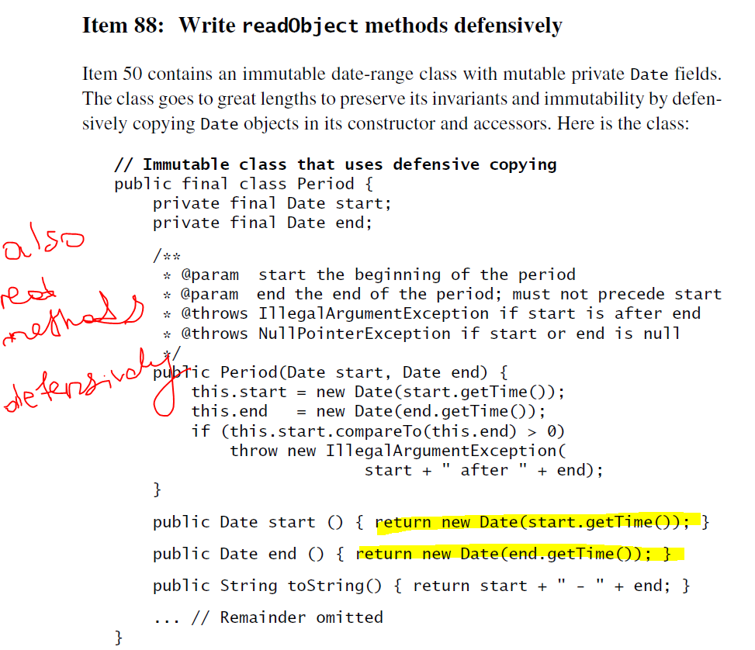

Slide 48
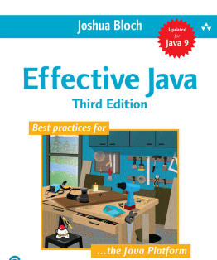
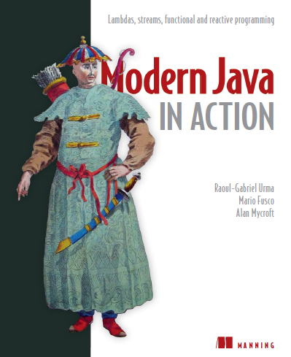
References
https://github.com/jbloch/effective-java-3e-source-code
https://www.manning.com/books/modern-java-in-action
Effective Java Items
Creating and Destroying Objects: Items 1-9
Methods Common to All Objects: Items 10-14
Classes and Interfaces: Items 15-25
Generics: Items 26-33
Enums and Annotations: Items 34-41
Lambdas and Streams: Items 42-48
Methods: Items 49-56
General Programming: Items 57-68
Exceptions: Items 69-77
Concurrency: Items 78-84
Serialization: Items 85-90
Modern Java in Action is divided into six parts:
Fundamentals (Behavior parameterization, Lambda Expression,..)
Functional-style data processing with streams
Effective programming with streams and lambdas
Everyday Java (New Date API, Java Module system, Optionals, ..)
Enhanced Java concurrency (CompletableFuture, Reactive Programming)
Functional programming and future Java evolution.
Notes:
JSLint can be found at http://www.JSLint.com/.

Slide 49

THANK YOU

Slide 50
Thank You
Notes:
https://developer.mozilla.org/en-US/docs/Web/HTTP/Caching

